Slide 1



Fresher Profiles Private Limited
19/04/2026
FACTORY SAFETY VOICE DETECTION SYSYTEM
PRESENTED BY:
Tarun B V
Sharath M
Spoorthi A G
Sneha B
Preethi Kumari

Slide 2
Problem Statement
Industrial environments operate under constant noise, restricted mobility, and time-critical risk conditions where traditional safety systems often fail to respond instantly. Workers cannot always access manual alert systems, leading to delayed emergency reporting and increased hazard severity. This project introduces a real-time, voice-driven safety system designed to detect critical commands such as “help”, “fire”, and “stop” even in high-noise environments.
Objectives
The objective is to enable hands-free emergency reporting
Improve response time
Enhance industrial safety through intelligent
context-aware decision-making.

Slide 3
Methodology
The system follows a real-time audio intelligence pipeline:
Continuous audio capture from factory environment
Voice Activity Detection (VAD) isolates speech
Noise reduction using spectral subtraction & Wiener filtering
Feature extraction via Log-Mel spectrograms
DS-CNN model performs keyword classification
Confidence gating ensures reliable predictions
Agentic AI layer analyzes context and triggers alerts

Slide 4
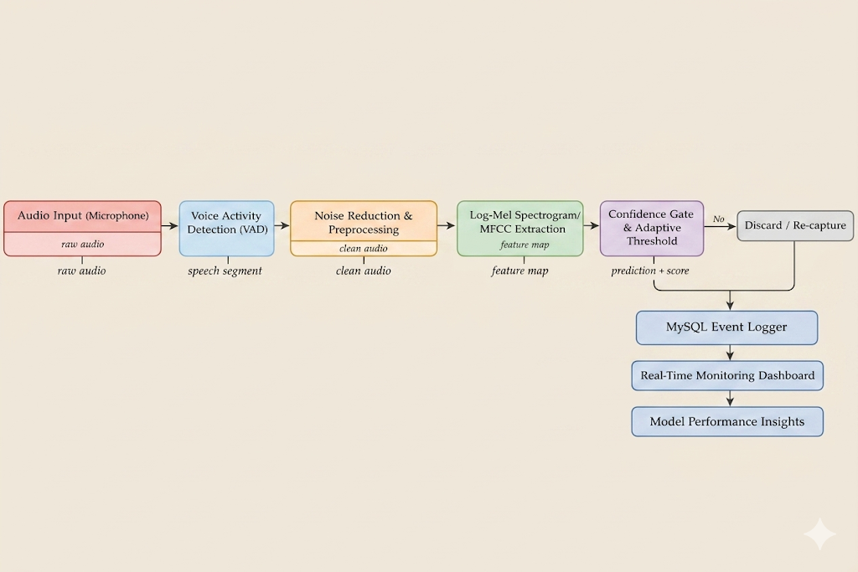

System Architecture

Slide 5
Results & Innovation
The system demonstrates strong performance in detecting safety-critical commands even under high background noise conditions. The integration of noise reduction and Log-Mel feature extraction significantly enhances accuracy, while the DS-CNN model ensures efficient real-time inference.
The key innovation lies in the Agentic AI alert layer, which enables context-aware decision-making by analyzing multiple parameters such as confidence score, noise level, and location. This allows intelligent alert generation rather than simple detection.

Slide 6
Thank You

